Slide 1


PLUS LIFE
“Mind the Gap”
RUSHERS
ROHIT KUMAR
ABHISHEK SENGAR
EDUTHON-EDUCATION THEMED HACKATHON
01

Slide 2
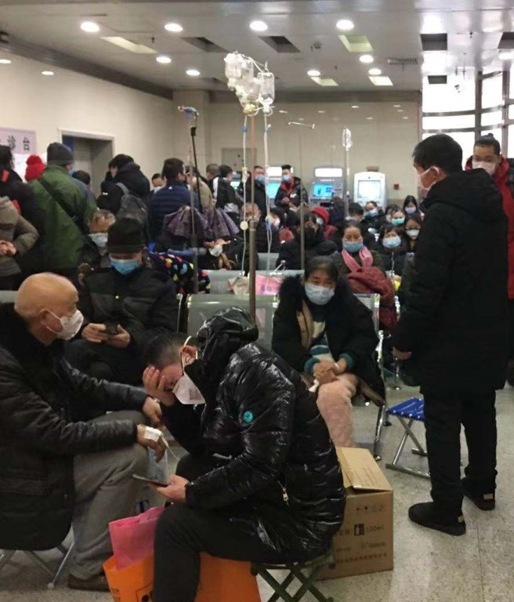
PROBLEM STATEMENT
In Hospitals / Private clinics , OPD can be a hotspot for infectious diseases (such as Covid-19) (due to crowd), a single person having disease can infect many other person who are there for normal routine checkup. During this pandemic, It is not safe for any person to visit any Hospital/clinic. It is not safe for the doctors and other people working at the hospital as well.
Situation of hospitals during this pandemic

Slide 3

PROPOSED SOLUTION
This problem can be reduced to a great extent by consulting with doctor online (through video calling) and visit Hospital / Clinic only when it is necessary or Recommended by Doctor itself. At least, first meeting with doctor should be held online.
We have build an online Platform where Patient consult Certified Doctors (of any private clinic / government hospital). A Doctor will have to register once with his/her genuine credentials and has to verify the documents and after successful verification Doctor can be consulted. Patient also has to register once with their genuine credentials and after that any patient can consult any specific doctor online (with this app) by choosing with categories such as fees, work-experience, working-week-days, degree,specialization etc . Doctor will send list of medicine names through mail and Patient can purchase it from nearest medical store. In this case a patient having normal disease can avoid going to Hospitals/Clinics , which will save a lot of time and reduce spread of the Infectious disease through hospitals/clinics.
We have made it more inclined towards ongoing pandemic.

Slide 4

UNIQUE SELLING POINTS
Easy to use. It is a very simple straight forward Web app.
A special COVID-19 section present in app to test the probability of anyone having covid-19 disease, by marking symptoms that you have.
Covid Visualizer to better Visualize the ongoing pandemic over the globe.
Easy, Secure and Fast Consultations with Doctors.

Slide 5

TECH STACK
1.
FRONT END
HTML
CSS
JS
2.
BACKEND
Node.js
Express.js
Mongoose
3.
DATABASE
MongoDB / Atlas

Slide 6
How it Works ?
Patient / Doctor have to register on the website once with genuine credentials. Username(email), Password will be used to login.
After login, user will be at their respective portal (Patient Portal / Doctor Portal).
Features of Patient Portal
Pending Appointments - List of all pending appointments of patient.
Book Appointment - To search doctor according to requirement and fix an appointment by making non-refundable fee payment.
After booking an appointment, a token will be given to patient and patient will have to wait for his/her chance.
Features of Doctor Portal
A dashboard to show current token no. and total tokens for that day.
Pending Appointments - List of all pending appointments of doctor
Both patient and doctor can join through a common url, generated through zoom api during appointment fixing.
Finally after meeting is over, doctor can provide list of medicines through mail and mark meeting as done.

Slide 7
THANK YOU
!

